Slide 1
The Story So Far
Module1 : Prehistoric America to the early Republic (20,000 BC – 1792
Module 2: From Republic to Continental Superpower (1792-1850)
Module3: From Continental to World Power (1848-1900)
Module 4: The reluctant giant (1900-1941)
Module 5: Master of the World (1941-1989)
Module 6: America and the multi polar world (1989-2024)

Slide 2
Module 3: from Continental to World Power
Talk | Title | Time Period | Date of Talk
16 | Competing destinies | 1848-1854 | March 4th
17 | The Union falls apart | 1854-1861 | March 18th
18 | Civil War | 1861-1865 | April 3rd
19 | Reconstruction & the New South | 1865-1900 | April 15th
20 | Conquest of the West | 1865-1890 | April 29th
21 | Triumph of capital | 1865-1894 | May 6th
22 | A world power emerges | 1890-1904 | May 20th

Slide 3
American History
1
Talk 16: The competition of destinies 1848-1854

Slide 4
Overview
Crisis of 1850
US mid century
The Kingdom of Zion
South rises to dominance
Crisis of 1856

Slide 5
Crisis of 1850

Slide 6
Election of 1848: the candidates
Democrats (low tariff and pro slavery) on track to victory
Euphoria from victory over Mexico
Economy booming
Polk retires after 1 term…replaced by slave owning Northerner as candidate
Whigs (high tariff, anti slavery)
Ignore slavery issue…too divisive
Choose Mexican war hero and southern slave owner Zachary Taylor as candidate
Balance ticket with northerner Millard Fillmore…indifferent to slavery
New “Free Soil” party emerges: no slavery in territories won from Mexico
Dems & Whigs ignore slavery issue: competition of ‘personalities’

Slide 7
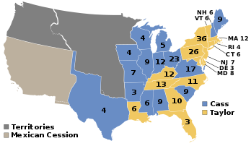
1848 Election results
War hero prevails
Whigs win 47% vote, Dems 43%
Free Soil wins 10% of vote
....no regional split
“Slave” or
“Free”?
Crisis after election as California
seeks admission as “Free State”
South rejects…fear loss of power
Northern states demand admission
..block vote for new Speaker
9 Southern States hold Convention
In Nashville…threaten to secede if
California admitted as free
Mexico will poison us”…Walt Whitman

Slide 8
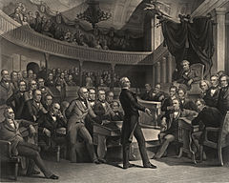
The Great Debate
Congress in chaos
…62 votes to chose a Speaker
…loaded pistols placed on desks
…Southern Senator Jefferson Davis
challenges Northerner to duel
Henry Clay “Great Compromiser” proposes
A deal to balance slave/free
Most famous debates in American
History:
John C Calhoun.. South
Daniel Webster…North
Henry Clay. North
Last hurrah for children of
Revolution.. Common experience
And trust from 30 years of debate.

Slide 9
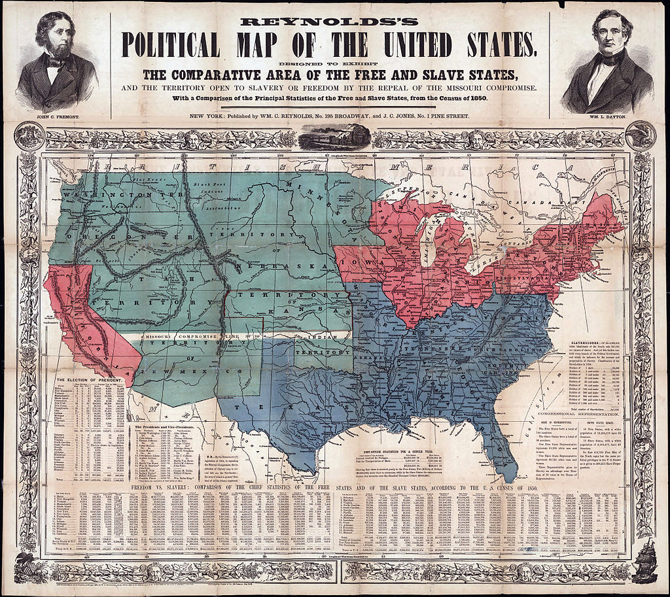
Crisis averted: “Compromise of 1850”
California admitted as “free”,
No slavery north of Missouri
Compromise line of 1820
New Mexico territory created out of Texas, Mormon territory to
become Utah… both exempted from Missouri compromise and allowed to choose “slave or free” …state sovereignty
FREE
FREE
Missouri Compromise Line``
?
FREE
SLAVE
S
Fugitive Slave Law
….each state required to return
escaped slaves to masters
Slavery issue “shelved”
…for now

Slide 10
US in 1850: a snap shot

Slide 11
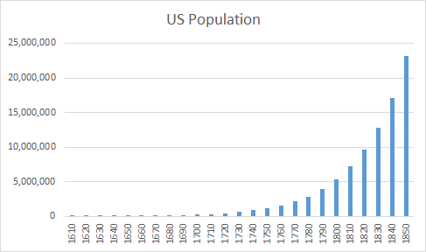
US Population 1850
Population at 23 million
rising 50% every decade
Tenfold increase since
Independence. Natural
Growth…Irish immigration
takes off 1845
United
States
Native Indian population
has collapsed 5 million in
1600, less than 500,000
By 1850
British America
Slave population 3.5 million ( 2 million in 1830)…..free blacks 400,000, 90% in north

Slide 12
Still mostly British and Protestant
 | 1790 | 1850
English | 55% | 50%
Scottish | 8% | 6%
Scots Irish (Protestant) | 10% | 8%
Catholic Irish | 1% | 5%
German | 5% | 8%
Free blacks | 2% | 2%
Black Slaves | 17% | 15%
Other (Dutch, Swedish, Mexican, other) | 2% | 6%
Total | 100% | 100%
90% Protestant with 75 denominations….less than 2% Anglican (Church of England)…most Methodist, Baptist, Presbyterian, Quaker, Unitarians

Slide 13
A Pre-Industrial Society
85% population in small towns and isolated communities (vs 97% 1790)
60% ‘free’ workforce farmers
20% domestic servants
10% manufacturing
Major cities emerging…mostly in the North
New York grows from 200,000 1830 to 515,000 by 1850
Baltimore 170,000, Boston 136,000, Philadelphia 120,000
North industrialising rapidly into diverse industries
South an expanding two crop economy: “cotton and tobacco”
…..sustained by slave labour

Slide 14
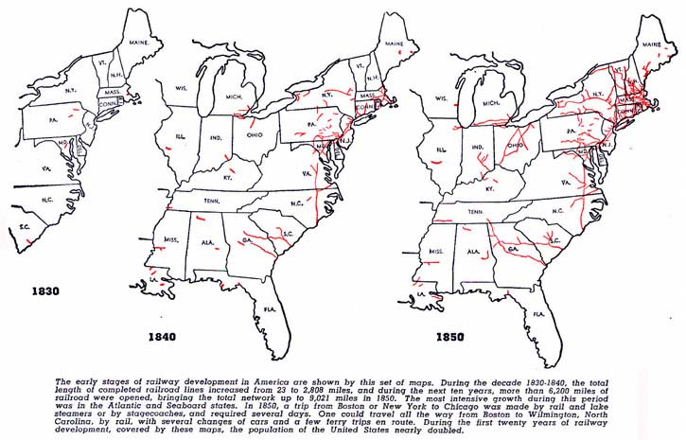
Expansion of railroads

Slide 15
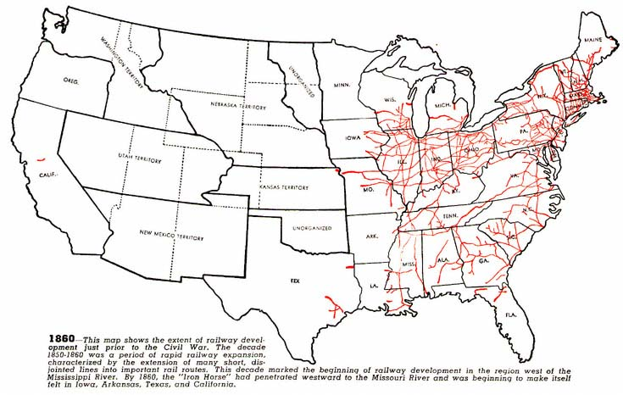
North & East integrated, South fragmented
34,000 miles
Of track by 1860
21,000 miles
North East
South more
Dependent on
River traffic

Slide 16
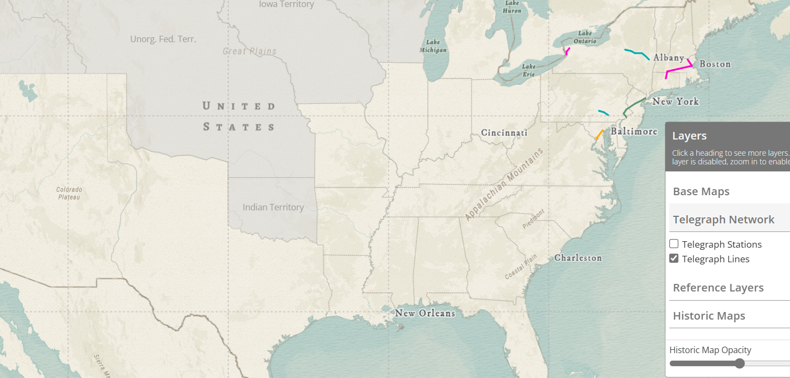
Expansion of Telegraph
Telegraph 1845
Telegraph 1855
Age of “instant news” has arrived
Integrated markets, consolidation and control of industry
90% of expansion in North and East

Slide 17
The 1850’s ‘look’….breakdown of barriers
Introduction of machine made clothes……spread of sewing machines
Men….top hats, trousers, jackets…..worn by all classes
Women…dome shape skirts, introduction of synthetic dyes

Slide 18
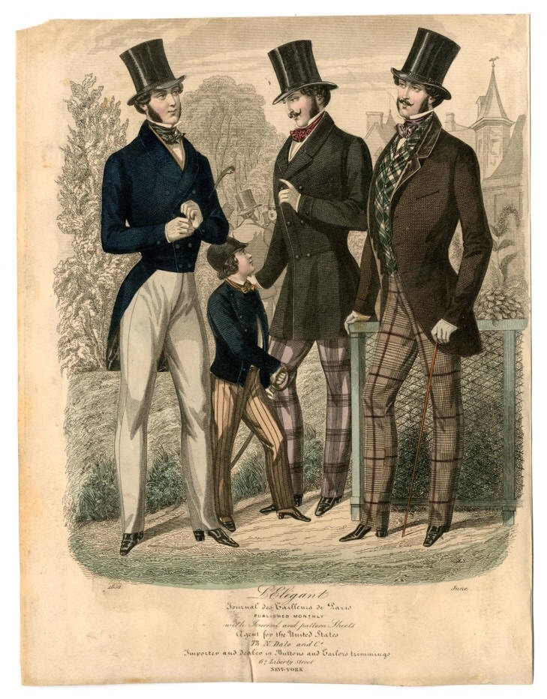
For men…Top hats and jackets

Slide 19
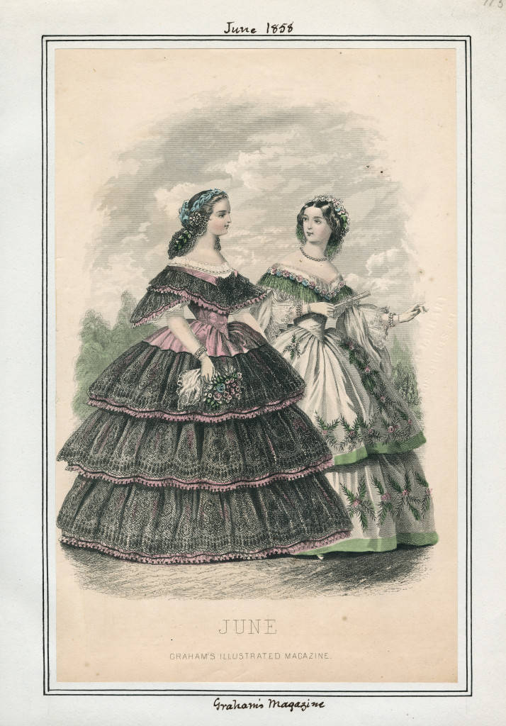
Dome skirts, bonnets, and colour

Slide 20
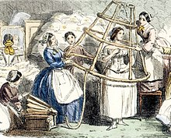
Caged Crinoline…..mass production for all classes …advantages…cheap, reduction in petticoats … disadvantages fire, cost, …..and getting caught in machinery

Slide 21
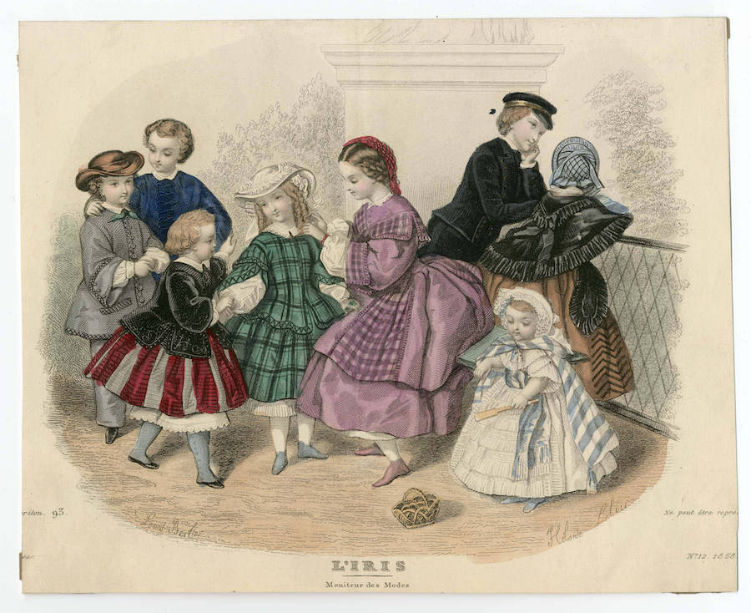
Children….little adults…boys skirts till 4..then loose trousers( sailor suits)….breeches at 14

Slide 22
America 1850
Dynamic society expanding, industrialising, confident
Slavery crisis avoided. South and North in balance…compromising
Two cultures emerging in parallel and coexisting
North…industrializing, ‘democratic’, moving to Mid West
South…agrarian, two crop economy (cotton and tobacco), slave based, expanding across south and west
Arrival of Mass immigration (1845+ ) ….disturbs equilibrium

Slide 23
Mass immigration

Slide 24
Mass immigration
Low from independence to 1840
………mostly British
600,000 arrive during 840’s
…….start of potato famine & Gold Rush
1,700,000 during 1850’s
…………mass exodus from Ireland
…………revolutions across Europe

Slide 25
The Irish

Slide 26
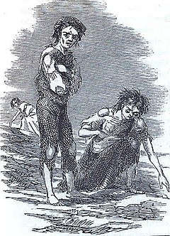
Irish Potato famine
Single crop/ absentee Protestant landlords
Politicians Protestant “Ascendancy” located in London
40% population relied entirely on potato to survive
Potato blight arrived 1845 …33% crop destroyed in 1845
British government reaction slow, partial, bureaucratic …and when corrected….too late
Robert Peel Conservatives…relief works, export restrictions, imports from Canada and US (wrong corn)
Lord Russel, Liberals take charge and 75% crop fails
“Laissez Faire” capitalism….’Irish problems, Irish solution
Lord Trevelyan: ‘Divine Providence’ lifts restriction on exports
Public Outrage. Relief resumed/ exports restricted 1847/48
World Reaction…first global famine relief
US sends 118 ships
Ottomans, Russians, Indian Kingdoms
Even Choctaw Indians from ‘Indian Territory”
Illustrated London News
1847

Slide 27
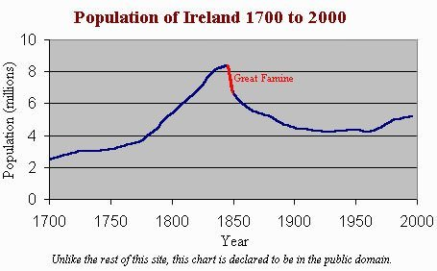
Irish catastrophe
2 million people left Ireland 1846-1855
1 million starve or die from disease
Young adults men and women leave
First, send remittances for families
Potato
introduced
25% emigrants Irish speakers….most
Unskilled settle in New York, Boston,
Philadelphia
“Although most certainly tired and poor, the Irish did
not arrive in America yearning to breathe free; they
merely hungered to eat. Largely destitute, many
exiles could progress no farther than within walking distance of the city docks where they disembarked.”
….www. History.com

Slide 28
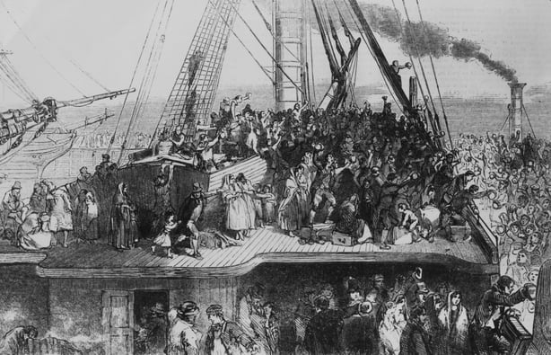
90,000 emigrants per year from Britain and Ireland

Slide 29
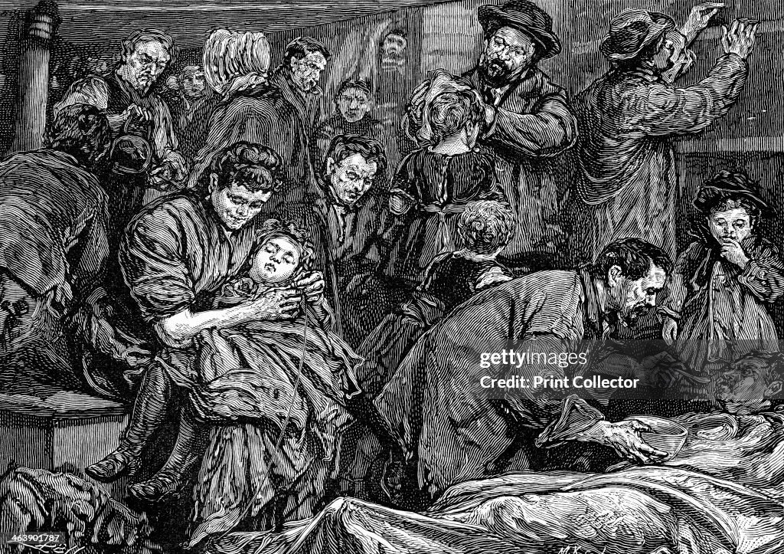
Transport on “Coffin Ships”…3% die en route

Slide 30
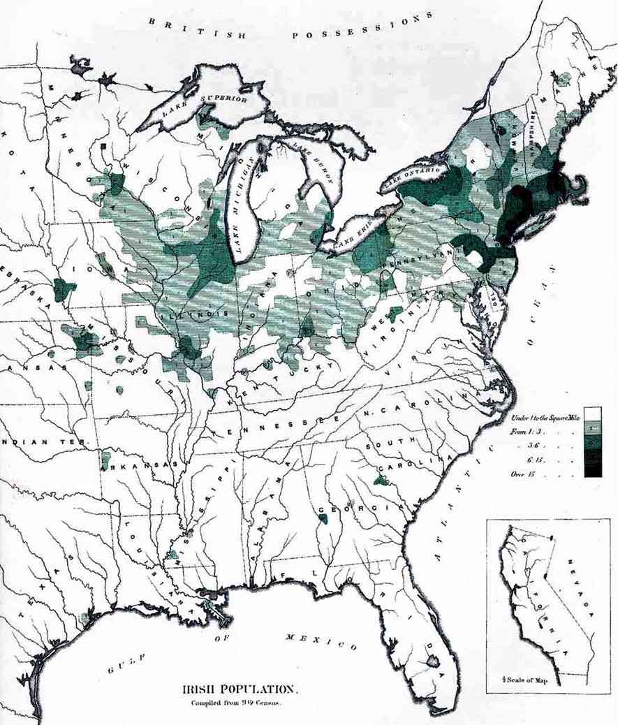
Irish population distribution 1890
90% Irish settle here
..in 1850’s

Slide 31
Impact of Arrival
Massive population increase to Northern cities and change in population
New York City population rises from 515,000 1850 to 820,000 by 1860 Irish from 5% to 33%
Boston from 130,00 to 180,000, Irish from 3% to 35% population
Native Protestants feel threatened…discriminate vs Irish…esp. 25% Irish speakers
Established Democrat dominance
‘Boss Tweed” New York Scotch Irish politician industrialises Irish
Provides housing and jobs …in exchange for votes (5 years residency)
Compete with ‘free blacks
Alliance Northern Irish Catholics with Southern Democrats: winning combination

Slide 32
The Germans

Slide 33
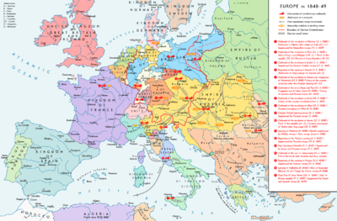
Revolutions of 1848
Liberal & Socialist Revolutions spread from Sicily across Europe
East & Central crushed by Autocrats, Austrian &
Russian Army and Catholic
Church within year
France…Military putsch
+ middle class. Napoleon III
…promise of New Empire
Britain: 2m Chartist march
on Parliament ..then go home!
Mass disillusionment &
Oppression across Germany
…future = America

Slide 34
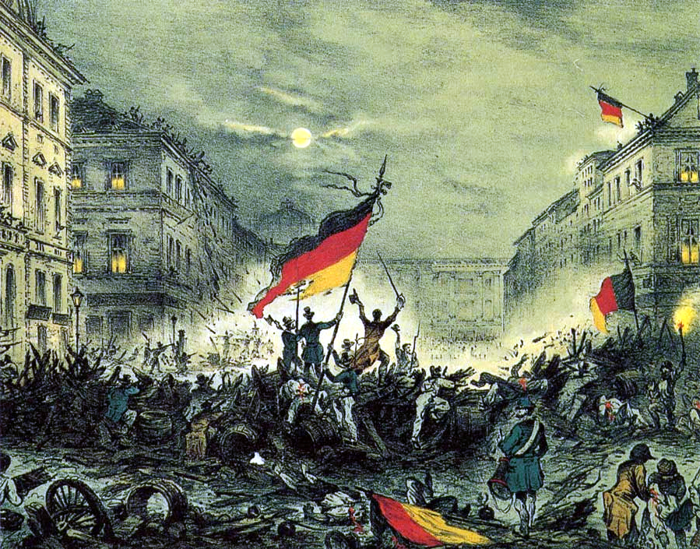
Revolution in Berlin 1848
Anti clerical German
Democratic Socialists
Seize power across
German kingdoms
Aristocrats ally with
Peasants and Austrian
Army and recover power
By end of year
Leaders executed
Exiled, or give up
On Europe…..

Slide 35
German Emigration 1850’s
Mostly middle class, politicians, journalists, young intellectuals and prosperous farmers seeking economic gain….disillusioned by victory of aristocrats
Better funded, skilled with higher literacy than Irish
Includes Socialists and radical politicians…fiercely anti slavery
Settle in Pennsylvania to integrate with existing communities…then move West
Most Protestant …..less of a threat to local population

Slide 36
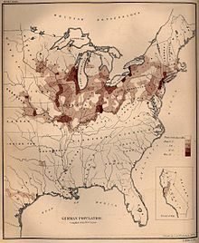
German migrants 1872
Spread Out Across North and Mid West

Slide 37
Mormon Kingdom

Slide 38
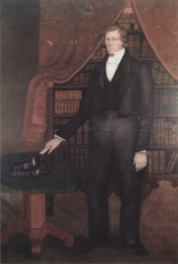
Mormons
Brigham Young (1801-1877)
Born Vermont….apprentice
Carpenter, glazier and painter
…moves west due to Panic of 1819
Becomes Methodist…works
for Mormons. Converts 1830
…meets Joseph Smith
Elected to “Quorum of 12
Apostles” ..Mormon government
Joins Smith at Nauvoo advocates
Polygamy
Assumes Leadership of Mormons
After Joseph Smith killed in 1844
Accused of counterfeiting…decides
To move west and find “Promised Land”

Slide 39
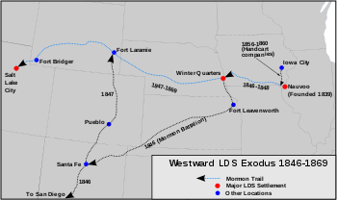
Mormon Pioneers
Brigham Young wanted
to establish Mormon settlement
on land no one wanted
Researched area…Salt Lake
..supplies for 1 year
First wagon train leaves 1847
73 wagons, 140 men, 3 women
, 2 children…highly organised
Use of hand carts
Follow Platte River “mile wide
Inches deep” West
Despatches “Mormon
Battalion” to support
Invasion of California

Slide 40
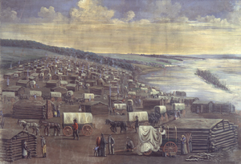
Winter Quarters

Slide 41
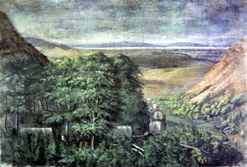
Arrival at Great Salt Lake

Slide 42
Settlement
Early Days
2,000 settlers arrive in valley 1847
Timpango Indians offer land and Deal…”don’t kill wildlife”….we don’t steal cattle
Indian ‘War’
Mormons arrive in 1,000’s, expand townships, kill wildlife, Indians starve and steal cattle
Brigham Young orders “selective extermination” in 1850
..kill all men, spare women and children “if they behave”
Mormon army surround Indian camp near Provo ….men surrender but lined up and shot in front of families..100 killed, 1 Mormon
Children and women become slaves to Mormon settlers…some escape
Brigham Young self appointed as Governor of ‘Utah’ territory and creates ‘Zion’
Establishes ‘theodemocracy’’ rule by church leadership

Slide 43
Utah War
Cause
Brigham Young wants to create “Deseret” …from Oregon to Mexican border
Promotion of polygamy…25% Mormons multiple wives. Abomination to Protestants
US government sees threat of new nation…declares Mormons in rebellion. Sends army
Meadowland Massacre
Mormons believe arrival of US army sign of “end of days”, wagon train ‘occupiers”
Ally with Piute Indians to attack wagon train…attack repulsed
Mormons guarantee settlers safety if they disarm, dress up as Indians and kill 120 adults and children over 4
US army arrives….digs up bones…...Brigham Young claims innocence
Peace Negotiations
Army occupies Salt Lake City, build forts
Peace Commission

Slide 44
Meadowland Massacre site

Slide 45
The agreement
“Deseret” boundaries reduced to current state of ‘Utah’
‘Theodemocracy’ replaced by US ‘model’’ but Church dominates
Commitment to investigate Meadowlands Massacre (scapegoat shot 1872)
No interference Mormon religion….polygamy continues
A “slave territory” but less than 300 slaves…..Indians moved to reservations
Utah thrives…. Population rises from 2,000 in 1850 to 50,000 by 1860, Salt Lake City 20,000… not accepted as “State” till 1890 after “new revelation” ‘banning’ polygamy

Slide 46
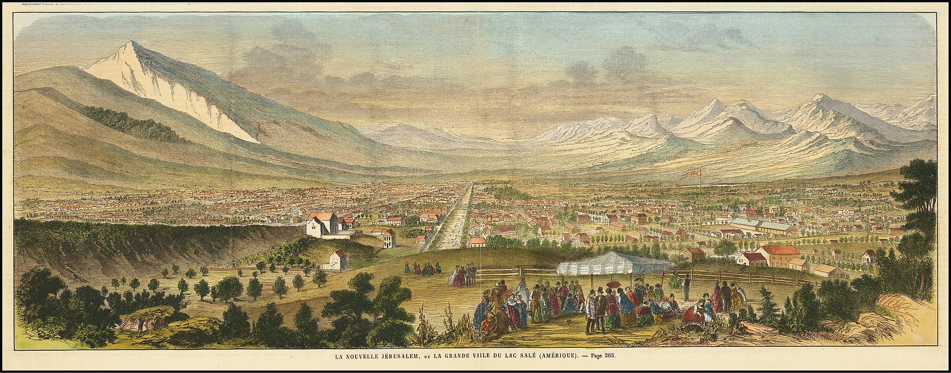
Salt Lake City 1863

Slide 47
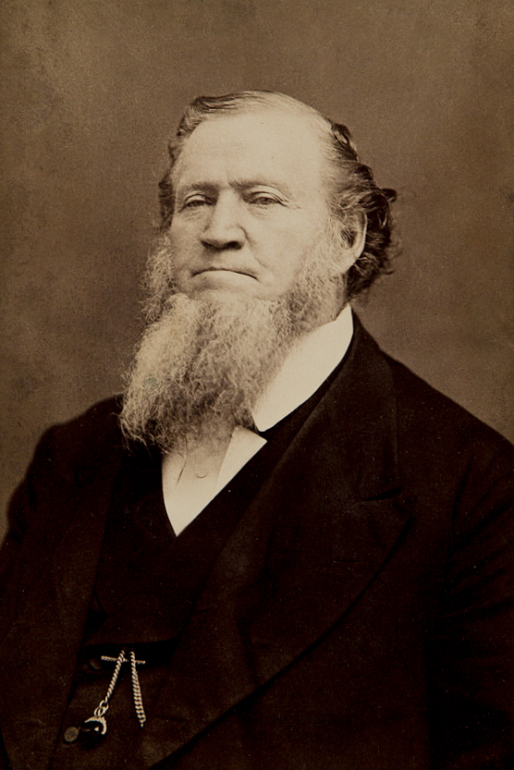
Brigham Young aged 70
Abraham Lincoln…asked by Mormon
what He will do with Utah
during the civil war…
..” Well, go tell Brigham Young ‘if he
if he leaves me alone, I will
leave him alone.”

Slide 48
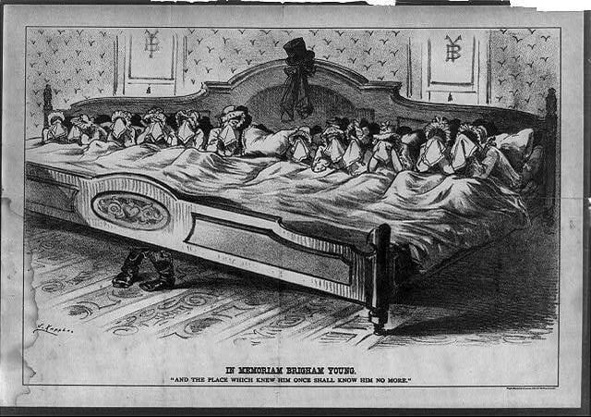
Brigham Young dies in 1877, aged 76 ….55 wives, 57 children…nation mourns…..

Slide 49
Intermission

Slide 50
The South
SOUTH

Slide 51
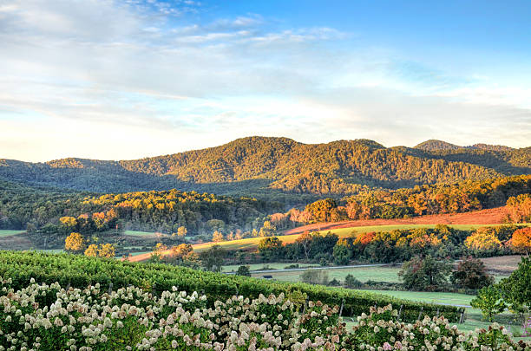
Virginia in autumn

Slide 52
South Carolina tree tunnels

Slide 53
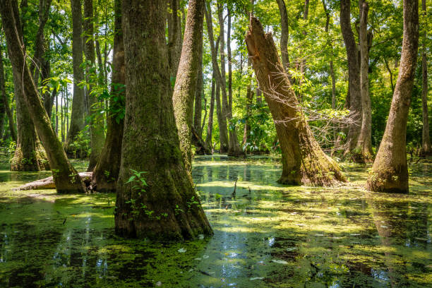
Mississippi swamp

Slide 54
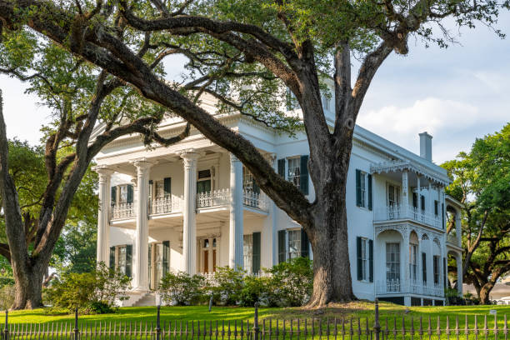
Stanton Hall…Natchez Mississippi

Slide 55
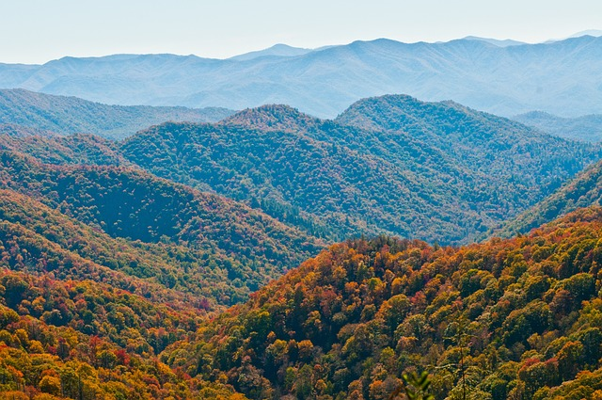
Appalachian Mountains

Slide 56
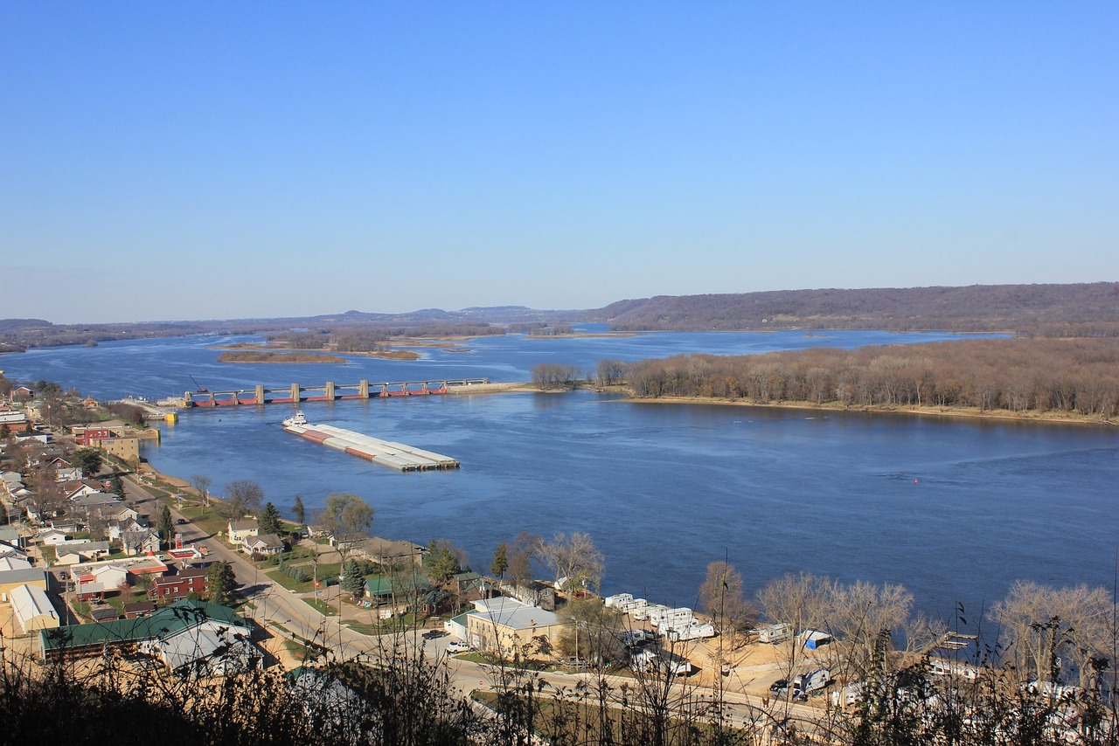
Mississippi River

Slide 57
“King Cotton”

Slide 58
Rise of “King Cotton”
Exports boom ….industrialisation….textile mills “clothing the world”
1830 …720,000 bales / 1860 5 million……..60% US Exports
Prices of slaves increase from $300 in 1830 to $800 by 1860s
Slave population increases from 2 million (1820) to 4 million (1860)
Atlantic Slave Trade banned 1808, enforced by British Navy
Non cotton growing Southern states breed slaves to “sell South
Value of slaves makes 60% of Southern Wealth

Slide 59
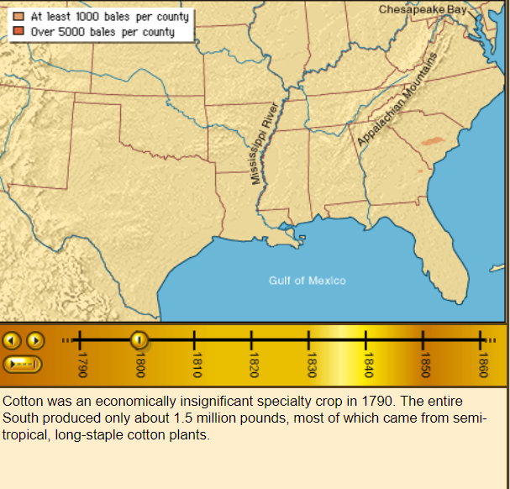
Cotton plantations 1800

Slide 60
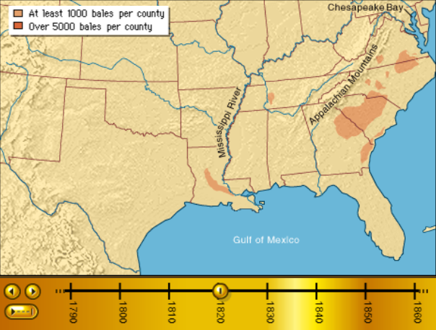
Cotton plantations 1830

Slide 61
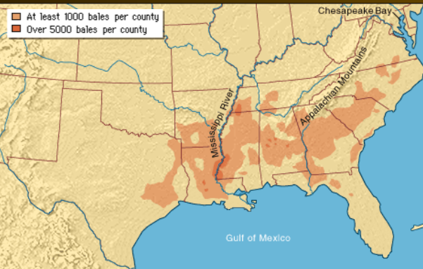
Cotton plantations 1860

Slide 62
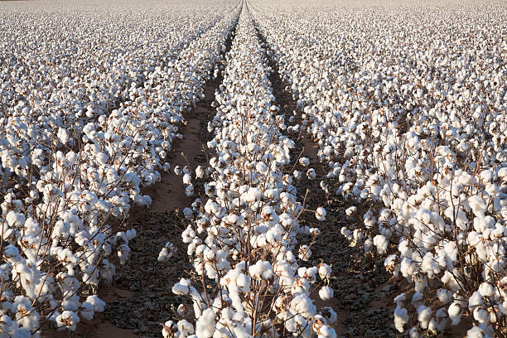
East Texas Cotton fields

Slide 63
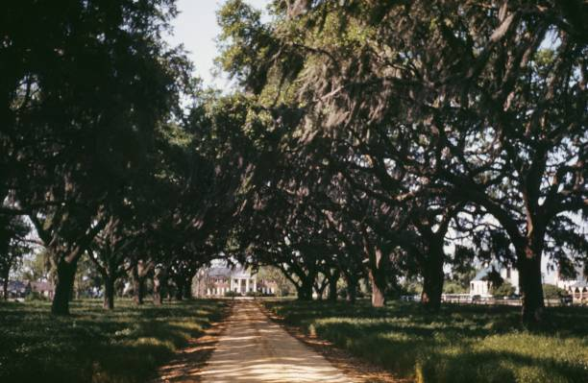
Plantation house…home of the top 2,000

Slide 64
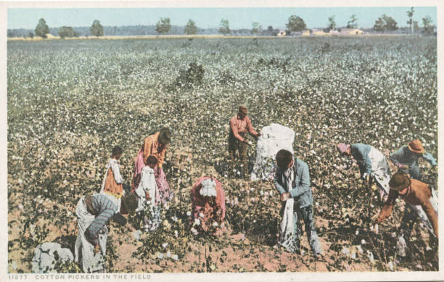
Slaves picking cotton Georgia 1850

Slide 65
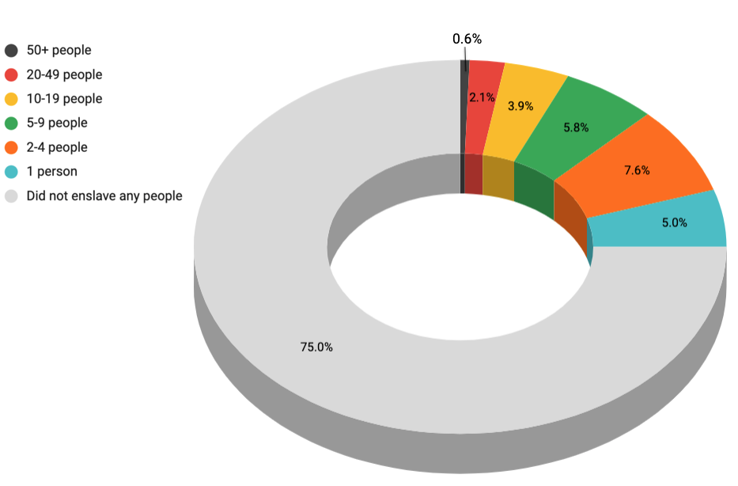
Most Southerners do not own slaves ……but want the right to do so
75% non slave owners
2,000 families owned more than
100 slaves… leadership class
Most slave owners own
2- 50 slaves. Member of family and store of wealth
Slaves 50% of South wealth..
Owning slaves aspiration of
Many…status symbol

Slide 66
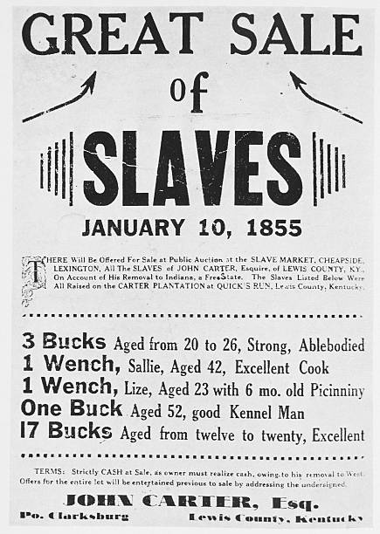
Slaves the principle source of wealth

Slide 67
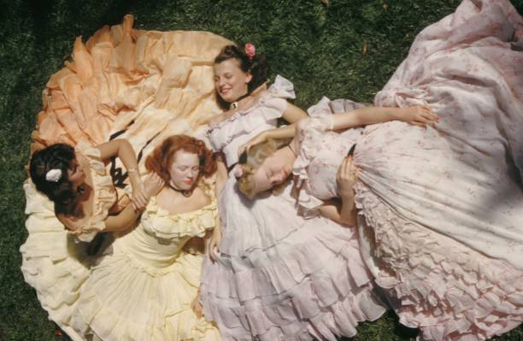
Southern Belles: above reproach, mostly uneducated—role of Southern man to protect

Slide 68
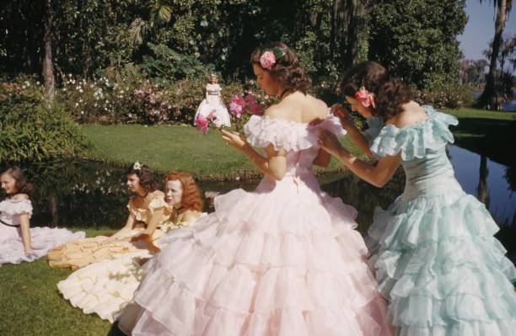
Southern ladies…the ideal image

Slide 69
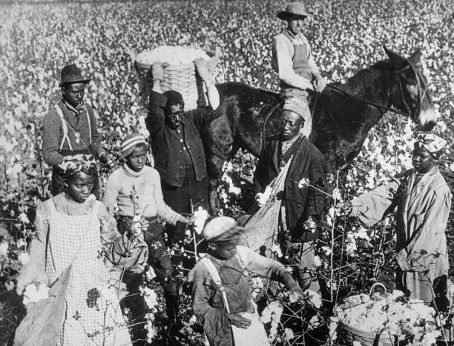
Cotton picking with overseer

Slide 70
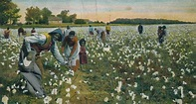
Picking Cotton

Slide 71
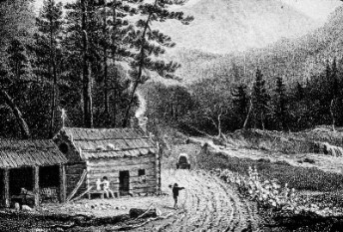
Poor whites…..75% of white population …..deferential, ‘manly’ loyal to elite , superior to blacks

Slide 72
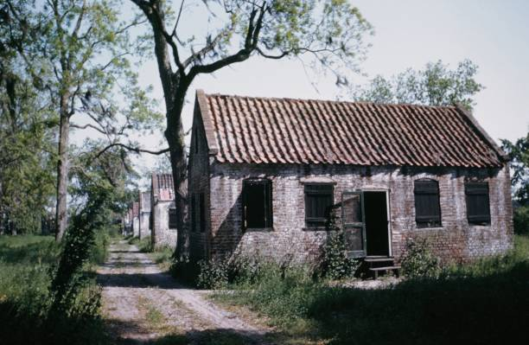
Slave quarters

Slide 73
Expansion blocked
Compromise of 1850: competition “slave” vs “free” in land taken from Mexico ……but new lands arid and not fit for cotton or slave economy
One answer…..create new states in Caribbean and Central America…with or without US government support
Enter the “Filibusters”

Slide 74
The Cuban Filibuster 1850-1851
Cuba 1850
Population 1 million…500,000 slaves,
Spanish crush Independence movement and retain control
Reject offer by US President Polk to buy island for $100 million
Southern politicians consider island ideal “Slave State”
Narcisco Lopez (ex Spanish officer and deserter)
recruits mercenary army to invade in 1850 from NY, blocked by US government
Moves south supported by Southern ‘expansionists”
Invades Cuba 1851…seeks allies with Cuban rebels…defeated, returns to US
Returns with 150 strong army of Americans, Germans, Spanish ‘filibusters”
Defeated, all arrested & shot…..except Lopez
…..garrotted in public square

Slide 75
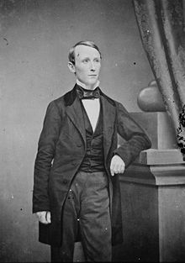
The “Grey Eyed man of Destiny”.
William Walker 1824-1860)
Born Tennessee…lawyer, medical student. Moved to New Orleans…”Believed in Manifest Destiny…vision: new US slave states in Mexico and Central America
Recruits army of 50 to invade Baja California….retreats
New plan….conquer Nicaragua …supported by “Knights of Golden Circle” influential secret society…
Recruits 50 strong army of “immortals to support rebels
Invades….wins….becomes President of Nicaragua recognized by US President 1856…reintroduces slavery, seeks to Americanise country,. English National language
Coalition of Central Americans attack…. retreats to US
Returns with 1860 with new ‘army of immortals’
Defeated….seeks escape on British Navy…..handed over to Honduras….and shot …together with ‘not’ immortals

Slide 76
South in mid 1850’s’
Booming cotton industry gives South great economic power, confidence, and
sense of invulnerability
Political Power ensured by alliance between Southern (pro slave) Democrats and new immigrants in North
Southern elites determined to expand slave economy
Confident of military power….wars with Mexico
Expansions south failing
Aware North expanding and industrialising more rapidly…increasing “Abolitionist”
Only option: Expand West and “break” Missouri and 1850 Compromise

Slide 77
Politics of mid 1850’s and crisis in Kansas

Slide 78
Election of 1852
Whigs offer another Mexican War Hero candidate: Winfred Scott
Refuses to comment on expansion of slavery…or anything else
Democrats pick reluctant compromise candidate Franklin Pierce
Compromise candidate….Northerner but indifferent to slavery
Committed to expansionism, pro Southern views
Whig vote split by third parties
“Native American Party” formed 1840’s….contests election for first time
Catholic world conspiracy …”replacing Protestant liberty
Includes ‘Whig ideas” :rights of working people, government welfare, rights
“Free Soil”
Ban slavery from ALL new territories

Slide 79
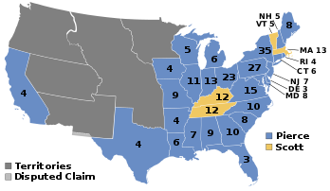
1852 election
A election of personalities…”least
Interesting Election in US history”
Democrats organise the vote
And score landslide
Whig Party obliterated
Anti Catholic and anti slavery
Voters believe election “stolen”

Slide 80
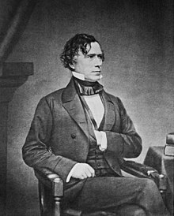
Franklin Pierce (1804-1869)
Born Vermont, Son of revolutionary war
Hero Successful northern lawyer
Joined Mexican War.. Debilitated by
Sickness and alcoholism
J
Popular Senator (deep voice. No opinions)
Son killed in train crash weeks after
election…wife claims death God’s
Vengeance for Pierce acceptance
Failed initiatives: buy Cuba (rejected), secure Nicaragua (Walker killed)
Buy block of land from Mexico for future
Railroad….pays $100m. Not used
Seeks to accommodate South, defers
to new rising star Stephen Douglas
Becomes bystander…often drunk

Slide 81
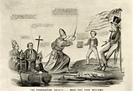
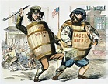
Political backlash…election stolen
Arrival of the Papists
Germans vs Irish…stealing the election
Ballot
Box

Slide 82
Rise of the “Know Nothings”
Secret societies develop in North reacting vs mass immigration
World wide Catholic Conspiracy crushed European revolutions of 1848
United states next target : Boston Minister about Catholics: “the ally of tyranny, the opponent of material prosperity, the foe of thrift, the enemy of the railroad, the caucus, and the school"
Convinced 1852 election “stolen” form National American Party
Movement spreads across East coast…answer “Know Nothing” when asked to explain policies
Politics becomes violent

Slide 83
New York Protestant Street Gang ‘Bowery Boys” ….

Slide 84
Dead Rabbits Riot, New York 1857
Independence Day riot at centre of Irish immigration ‘5 Points” New York
Protestant “Bowery Boys” attack
Irish gang “Dead Rabbits”
1,000 involved, New York in chaos
For 2 days
State Militia imposes order..8 killed, 100’s Injured. Wide spread looting

Slide 85
Bloody Monday riots Louisville Kentucky 1857
Governor elected…
Election considered
Rigged by Democrats
“Know Nothing” mob
Attack Irish and German
Communities….fighting
Stopped by militia 25 killed,
100 buildings burned
Riots consume attention
North and East...slavery
Issue remains on hold

Slide 86
The issue of Kansas
Decision needed on whether slavery allowed in new territories
Most land north of agreed Missouri Compromise
South believe it their destiny to expand slavery
North believe it their destiny to prevent its expansion
Great Compromisers: Clay, Webster, and Calhoun die 1850-53 ….new generation of deal makers needed

Slide 87
The Little Giant
Stephen Douglas (1813-1861)
Northerner married into
Southern aristocracy
Believes himself new generation
of “great compromisers” (Clay,
Webster, Calhoun;
Engineers a “great compromise”
Kansas Nebraska Act of 1854
The most disastrous piece of
Legislation in US history

Slide 88
The deal
Missouri Compromise abandoned
Kansas
Territory
Kansas & Nebraska created
Missouri Compromise
line
Settlers to decide if territory slave or free. No thought on how
Fugitive Slave law enhanced
….Southerners given right to collect escaped slaves
….fine of $1,000 to anyone who
attempts to help/hide slaves

Slide 89
Northern reaction
Slave
Douglas
Pierce

Slide 90
Unexpected consequences
Southern “slave catchers” enter Northern States to collect slaves
………..Abolitionists resist with violence
……..…Some States ban return of slaves
Slave owners move into Kansas, claim residency, vote for slavery
…………elect “Governor....
“Free soilers” do the same….two Governors same place
…Enter “free soiler” and Abolitionist zealot John Brown
…” Second Coming” delayed by existence of slavery
There is nothing he will not do to abolish slavery

Slide 91
……….There will be trouble…see Talk 17

